Slide 1
STATE
APPLICATION
Dr. Jose Annunziato

Slide 2
HttpSession
HTTP is a stateless protocol
HTTP servers can't distinguish one request from another
Cookies can store distinguishing information
Servers use cookies to distinguish requests and remember
HttpSession is an API built on cookies to distinguish and store and retrieve data for related requests
Cookies can be used to track users over time

Slide 3
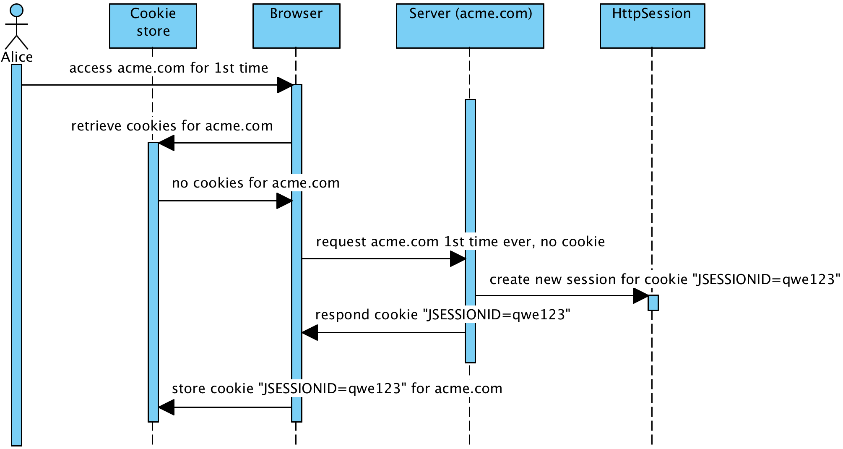
HttpSession sequence diagram

Slide 4
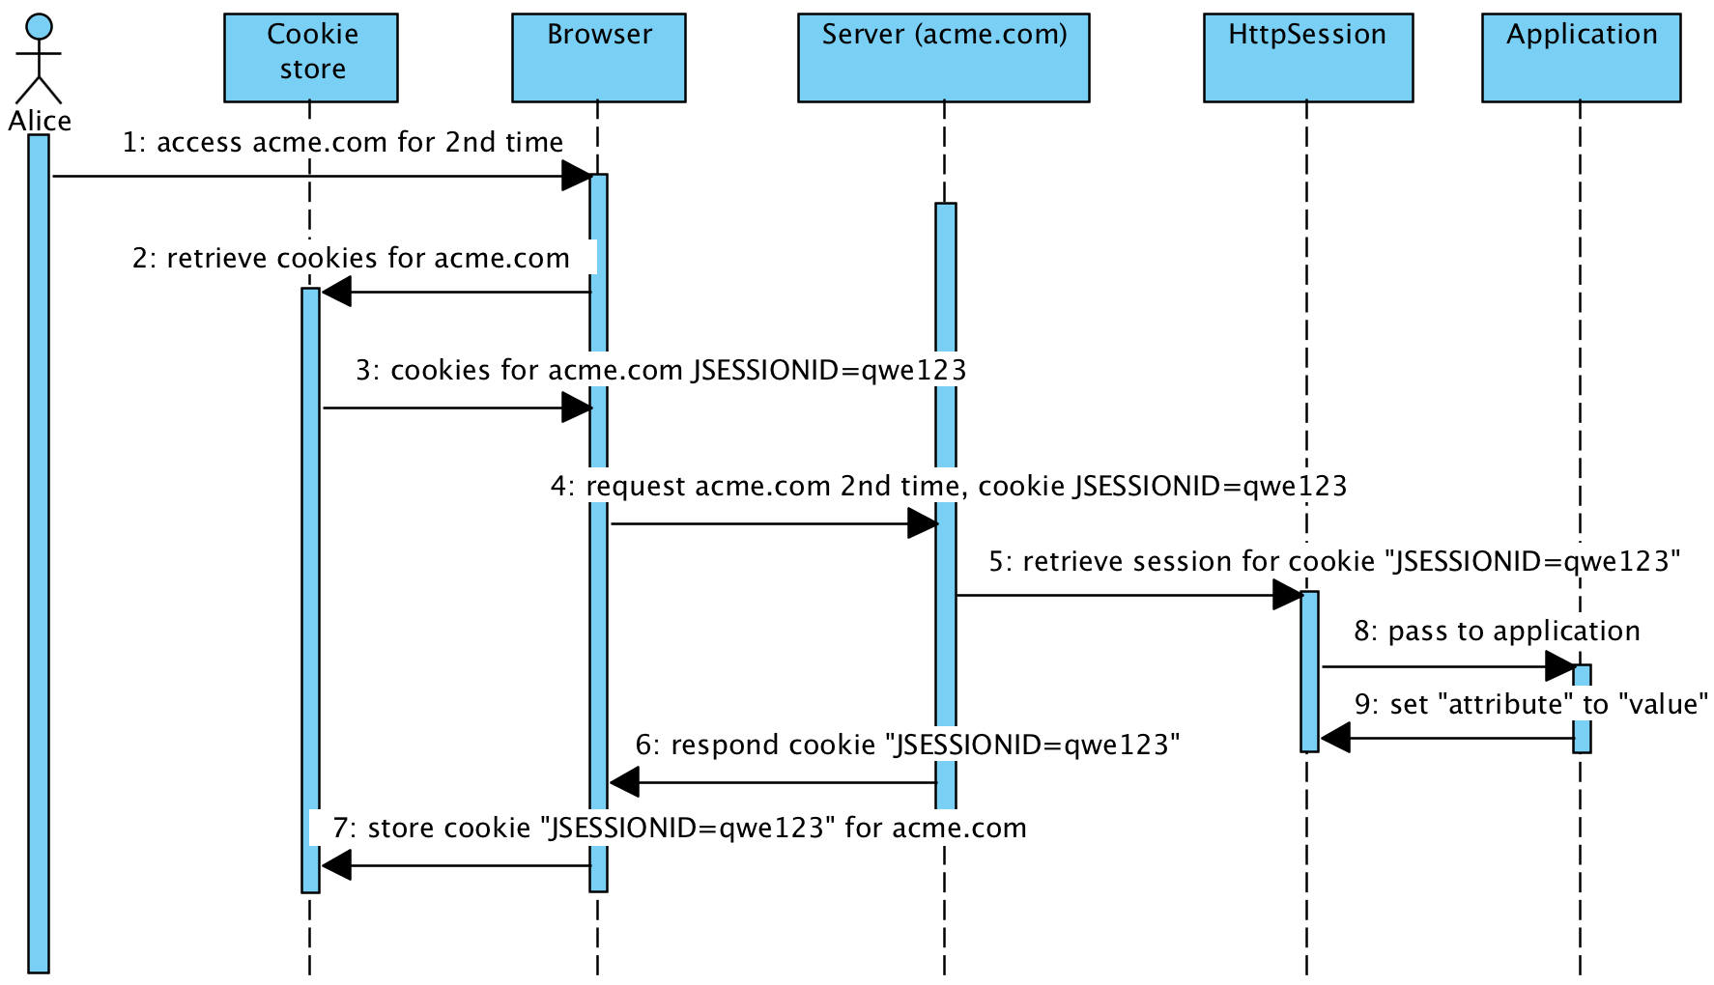
Setting An Attribute

Slide 5
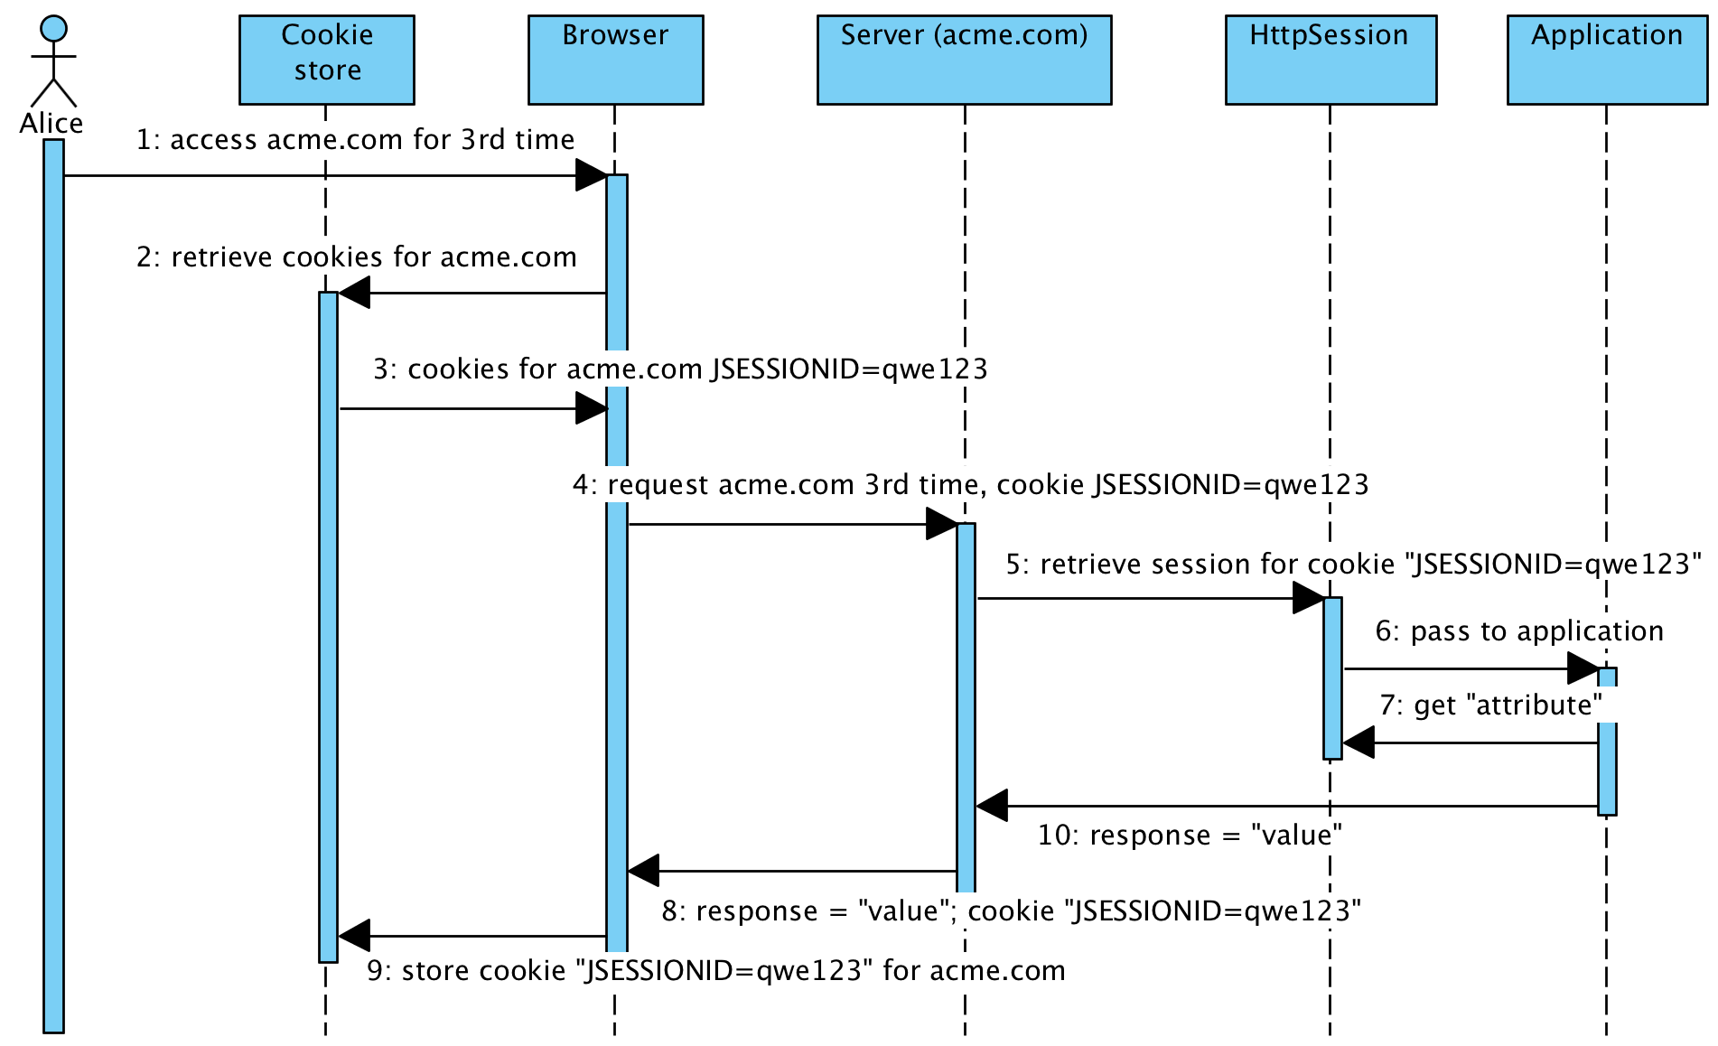
Getting An Attribute

Slide 6
HttpSession examples
@RestController
public class HttpSessionExamples {
… next several slides …
}

Slide 7
Setting session attributes
@GetMapping("/api/session/set/{attr}/{value}")
public String setSessionAttribute(
@PathVariable("attr") String attr,
@PathVariable("value") String value,
HttpSession session) {
session.setAttribute(attr, value);
return attr + " = " + value;
}

Slide 8
Retrieving session attributes
@GetMapping("/api/session/get/{attr}")
public String getSessionAttribute(
@PathVariable ("attr") String attr,
HttpSession session) {
return (String)session.getAttribute(attr);
}

Slide 9
Invalidating session
@GetMapping("/api/session/invalidate")
public String invalidateSession(
HttpSession session) {
session.invalidate();
return "session invalidated";
}

Slide 10
LOGIN & REGISTER w/ HTTPSESSION

Slide 11
Registering as a new user
List<User> users = new ArrayList<User>();
@PostMapping("/api/register")
public User register(@RequestBody User user,
HttpSession session) {
session.setAttribute("currentUser", user);
users.add(user);
return user;
}

Slide 12
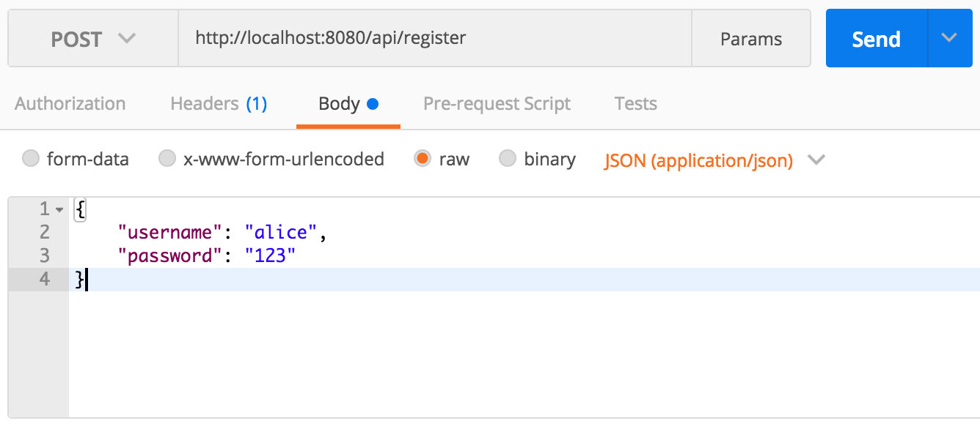
Use Postman to test Web service

Slide 13
Retrieving profile from session
@GetMapping("/api/profile")
public User profile(HttpSession session) {
User currentUser = (User)
session.getAttribute("currentUser");
return currentUser;
}

Slide 14
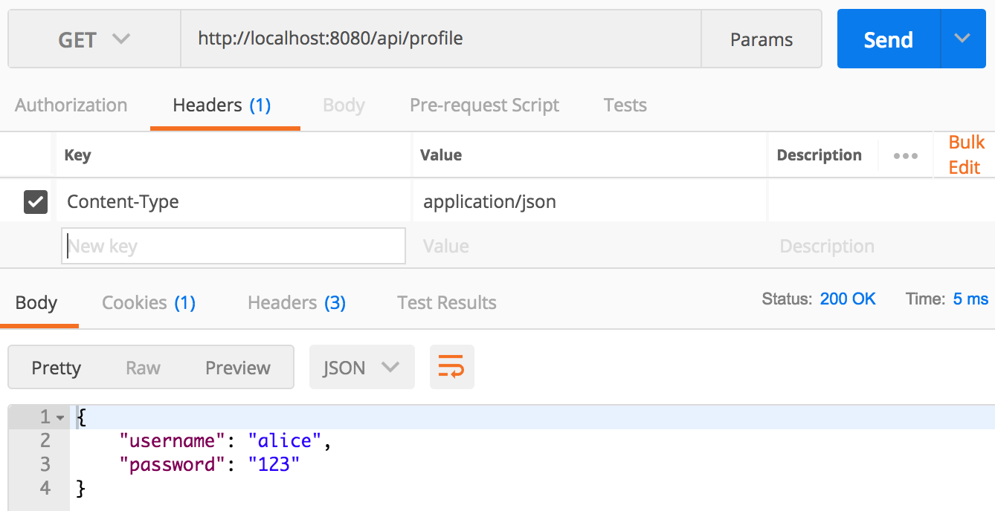
Use Postman to test Web service

Slide 15
Logout
@PostMapping("/api/logout")
public void logout
(HttpSession session) {
session.invalidate();
}

Slide 16
Login passing credentials
@PostMapping("/api/login")
public User login( @RequestBody User credentials,
HttpSession session) {
for (User user : users) {
if( user.getUsername().equals(credentials.getUsername())
&& user.getPassword().equals(credentials.getPassword())) {
session.setAttribute("currentUser", user);
return user;
}
}
return null;
}

Slide 17
